Slide 1
Beyond Pixel Norm-Balls: Parametric Adversaries Using an Analytically Differentiable Renderer
Hsueh-Ti Derek Liu, Michael Tao, Chun-Liang Li, Derek Nowrouzezahrai, Alec Jacobson ICLR 2019
Alexey Gavryushin | agavryushin@student.ethz.ch
ETH Zurich | Advanced Topics in ML & Data Science | 18 May 2022
Notes:
Good afternoon everyone.
I’m Alexey Gavryushin, a master’s student in Computer Science at ETH Zurich. And I would now like to present you the ICLR 2019 paper «Beyond Pixel Norm-Balls: Parametric Adversaries Using an Analytically Differentiable Renderer» by Hsueh-Ti Derek Liu et al.
We’ll try to understand what this paper did step-by-step. Fernando and I agreed that to do so, we should devote some time to introducing the concept of adversarial examples first, so you can better understand the contribution of this paper.
00:35

Slide 2
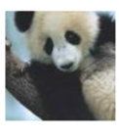
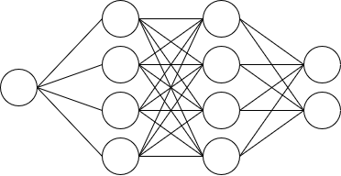
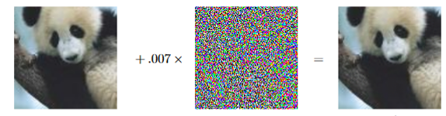
Adversarial Examples
"panda" 57.7% confidence
"gibbon" 99.3% confidence
adversarial perturbation
Also possible with audio, text, …
Explaining and Harnessing Adversarial Examples; ICLR ‘15
Notes:
What exactly are adversarial examples?
In the diagram on the slide, you can see the image of a panda being processed by a classifying neural network. The network, in this case, correctly predicts the image‘s label.
In the bottom diagram, the pipeline is altered by adding an additional adversarial perturbation to the input image before forwarding it through the classifier. We will take a look at how such adversarial perturbations can be computed shortly. For now, simply note that we multiply this adversarial perturbation by a small scalar before adding it to the original image, such that the altered image does not differ from the original one to the human eye.
Yet, the *network* seems to be very sure that the altered image shows a gibbon, based on the high confidence score.
It should be noted that adversarial examples are not limited to images and also exist for other modalities such as audio. Adversarial examples were first observed by Christian Szegedy et al. in 2014. Since then, there has been a large body of research about adversarial examples and how to protect neural networks against them.

Slide 3
Classes of Adversarial Attacks
White-box attacks | vs. | Black-box attacks
Targeted attacks | vs. | Untargeted attacks
Notes:
An adversarial attack is then the attempt of constructing an adversarial example intended to mislead â given neural network.
We can distinguish two orthogonal classifications of such attacks, namely one classification into white-box and black-box attacks, and another one into targeted and untargeted attacks.
02:05

Slide 4
Classes of Adversarial Attacks
White-box attacks | vs. | Black-box attacks
Targeted attacks | vs. | Untargeted attacks
Notes:
Let’s look into the difference between a white-box adversarial attack and a black-box adversarial attack first.
02:10

Slide 5
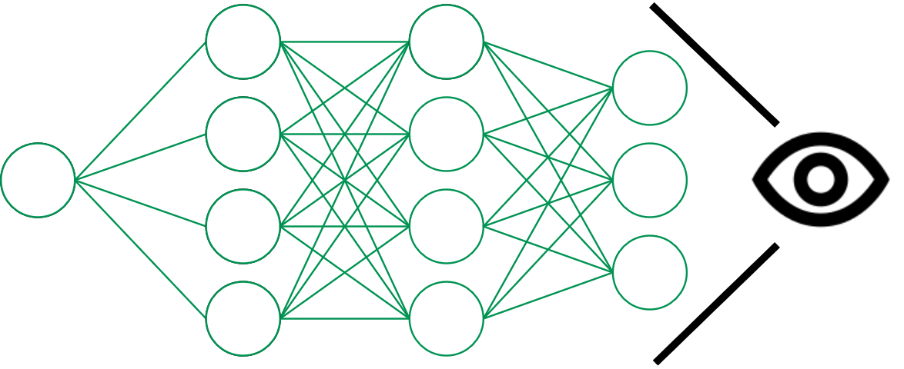
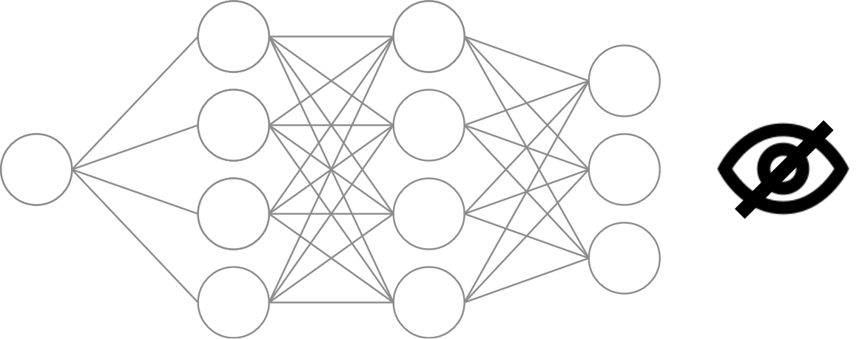
Classes of Adversarial Attacks
White-box attack
Attacker aware of model architecture
and parameters
Black-box attack
Attacker only aware of model architecture and/or outputs produced from
certain inputs
Notes:
Distinction criterion is pretty simple:
White-box attacks assume knowledge of the attacked model’s architecture *and* its parameters,
whereas…
black-box attacks limit the attacker’s knowledge to the architecture of the model and/or the outputs produced by processing certain inputs.
02:30

Slide 6
Classes of Adversarial Attacks
White-box attacks | vs. | Black-box attacks
Targeted attacks | vs. | Untargeted attacks
Notes:
Finally, we can distinguish targeted and untargeted adversarial attacks.
02:32

Slide 7
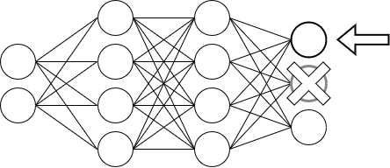
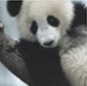
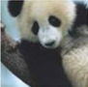
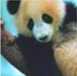

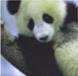
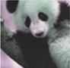
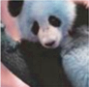
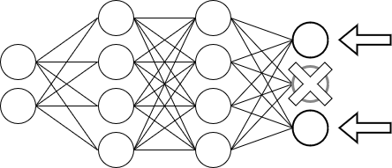
Classes of Adversarial Attacks
Targeted attack
specific target label
ground-truth label
original
example
potential
adversarial examples
neural network
Untargeted attack
arbitrary non-GT label
ground-truth label
arbitrary non-GT label
original
example
potential
adversarial examples
neural network
Notes:
Targeted adversarial attacks alter the input of a given classifier in an attempt to cause the classifier to predict a specific label y_Target that is distinct from the ground-truth label.
*Un*targeted attacks simply aim to cause the classifier to output a label that does not correspond to that of the ground-truth.
02:50

Slide 8
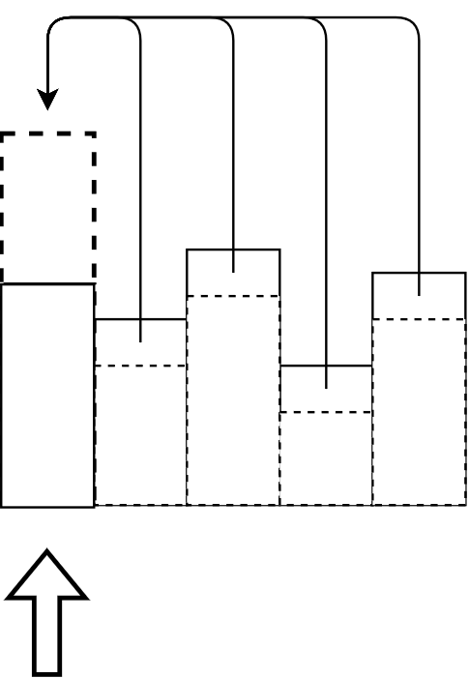
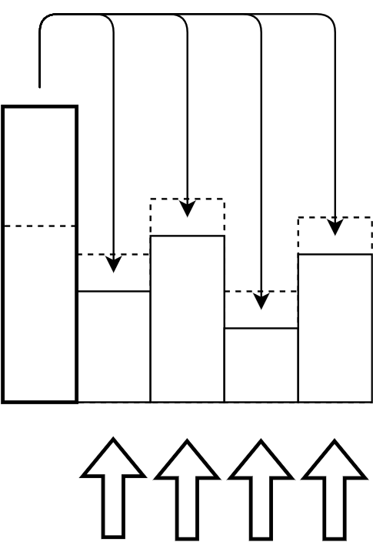
White-Box Attack: PGD
Projected gradient descent
Targeted attack
y₀ = y_{Target}
y₁ = y_{Original}
Probabilisitic mass transferred
from all labels to y_{Target}
Untargeted attack
y₀
y₁ = y_{Original}
y₂
‘
Probabilisitic mass transferred
from y_{Original} to other labels
Notes:
Let’s use white-box attacks to illustrate how we could construct an adversarial example. We will look at a particular type of attack involving projected gradient descent (or PGD).
We can perform either a targeted or an untargeted PGD attack.
To perform a targeted PGD attack, we first start with some example, not necessarily from the dataset. We call this initial example x^0.
As you can see in the equation, at each timestep, we take the current example x^t and subtract the derivative of that example with respect to some loss function between the network’s predicition and the desired label y_Target. This gives us our updated example x^(t+1) . The loss function can for instance be a cross-entropy loss. The subtracted derivative is weighted by some hyperparameter. We’ll ignore the projection operator here and look into that in a moment.
An intuitive way to think about targeted attacks is that probabilisitic mass gets transferred from all labels, including the original label, to the target label. This means that we want to make it more likely that the network predicts y_Target.
To perform an *un*targeted PGD attack, we instead *add* the derivative of the example with respect to the loss function between the network’s predicition and the original label y_Original. This has the effect of increasing the loss between the network’s output and the label of the original example, and hence should make it less likely that the network predicts y_Original.
The intuition here is that we transfer probabilistic mass from the original label to all other labels. In comparison to a targeted attack, it may thus take a longer time until we manage to obtain a different label. However, untargeted attacks are better suited than targeted ones for defending neural networks against adversarial attacks, as we will see shortly.
04:50

Slide 9
White-Box Attack: PGD
Projected gradient descent
Targeted attack
Untargeted attack
Possible to combine both
‘
Notes:
Note that it is also possible to combine both a targeted and an untargeted PGD attack, for instance by including both underlined terms in the update rule and weighting them differently.
05:02

Slide 10
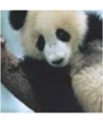
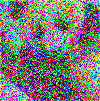

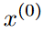
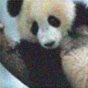

Projection
Distorted example
obtained by one/multiple updates
ε
Original example
Projected example
Notes:
Now, let’s look at the role of the projection operator here.
Intuitively, it ensures that we always stay within some epsilon distance of the original example, and our adversarial example still maintains some similarity to the original.
Even if the hyperparameter lambda circled in yellow here allows us to control the magnitude of the change we make during a single update, this would not prevent a gradual drift towards the boundary of the ground-truth class and eventually to a visually dissimilar sample that might be heavily distorted. It is unlikely that such heavily distorted samples would be encountered in the training data.
By projecting to some epsilon-neighborhood of the original example x^(0), we can avoid this problem.
(NB, if someone asks: if we defend our classifier against such samples, it will most likely hurt the performance of the classifier, since we are training it to classify junk to some label)
(Note: I decided to remove the husky image because it’s much more likely to get a heavily distorted sample than a realistic sample from another class; the original text was:
After all, if we were not constraining the resulting adversarial example in any way, the simplest thing would be to take an image from another class and have the network simply predict that label.)
06:00
---
Prof:
-> not moving one sample, but moving toward boundary of class
-> e.g. here: Panda and husky close; Panda and plane: will have to move farther

Slide 11
Projection
How to define this "neighborhood"?
ε
Original example
Projected example
Notes:
A natural question, then, is how to define this neighborhood in precise, mathematical terms.
06:06

Slide 12
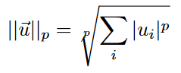
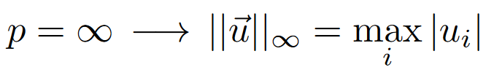
Normballs
ℓ^{p}-norm of vector:
Notes:
This brings us to the concept of normballs.
An ℓ^{p}-*norm* of a vector u is defined as the p-th root of the sum of all elements of that vector, where we take the absolute value of each element and raise it to the p-th power.
Norms can naturally be used to measure the distance between vectors by subtracting one vector from another and taking the norm of the difference.
One special case should be noted: if p is infinity, this formula returns the absolute value of the largest element in the vector u.
06:38

Slide 13
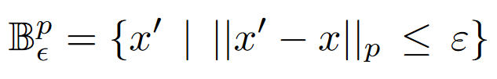
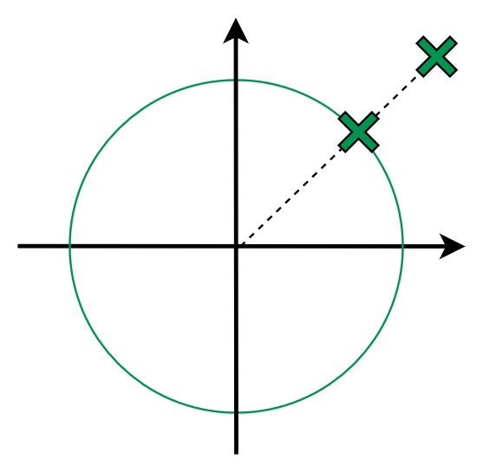
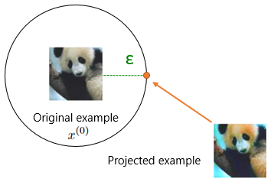
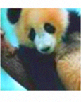
Normballs
ℓ^{p}-norm of vector:
ε-sized ℓ^{p}-normball around point x:
ℓ^{p}-distance of x’ to x
Euclidean projection z’ of point z onto ε-sized
ℓ^{p}-normball around point x:
with images & pixel normballs:
z
ε
z’
x
here, p=2; 2D vectors
limited possibility of semantic
changes (distance too large)
Notes:
The ε-sized ℓ^{p}-normball around point x is then the set of all points x’ with an ℓ^{p}-distance to x that is less than or equal to ε
Lastly, the Euclidean projection z’ of a point z onto the epsilon-sized ℓ^{p}-normball around point x is defined as the point that is closest to z inside the ℓ^{p}-normball around x, in terms of the Euclidean distance. The Euclidean distance is the L2 norm.
Here we see an illustration of the Euclidean projection of the point z onto an l2-normball of radius epsilon around the point x in 2D.
Now, we have a mathematical characterization of the projection of adversarial examples that we were intuitively reasoning about earlier.
The vectors, in our case, are images. Each pixel is then an element of the vector. Constraining the adversarial example to lie within a certain normball of the original example ensures that the adversarial example does not get distorted too strongly.
Importantly, in the case of images, this limitation of the pixel-wise changes to a normball typically means we cannot perform a *meaningful* altering of the image’s content and are limited to just adding meaningless noise (which is not random though, because we move to/from a certain direction).
The noise we add will thus simply lift the sample out of the manifold of realistic data instead of producing a similar image with some meaningful difference to the original example, such as a significant change in illumination.
08:36
if anyone asks:
e.g. text: adding „no“ would already change meaning dramatically.

Slide 14
Defenses Against Adversarial Attacks
e.g. some ℓ^{p}-normball
During each training iteration:
Adversarial attack used within defense!
Draw sample x with label y from training set
2. Find x’ in Neighborhood(x) maximizing loss
3. Minimize loss for x’, y and current parameters θ
Notes:
Let’s move on to possibilities of defending neural networks against adversarial attacks.
Naturally, we might wonder whether it is possible to protect neural networks against the types of adversarial attacks we just discussed.
A very simple method involves the following procedure which is also encoded in the formula you see on the slide:
During each training iteration, we draw a sample x with an associated label y from the training set.
Using adversarial attack methods such as projected gradient descent, we then attempt to find a sample x’ in the neighborhood of x which maximizes our loss function.
The neighborhood could for instance be some ℓ^{p}-normball, as we just discussed.
It should be noted that the x’ we find might not correspond to the actual point maximizing the loss in the neighborhood of x, as for instance PGD will be stopped after a certain number of iterations, so we might not reach the maximum.
Again, take note that we perform an adversarial attack on our own network while making the network more robust here. This means that typically, if you come up with a method of adversarially attacking a network, you can just use it in this defense mechanism to defend your network against it.
After we find x’, we change the parameters of the network being trained to minimize the loss between x’ and the correct label y.
After repeating this procedure for many iterations, we can hope to increase the robustness of our neural network against adversarial attacks.
10:30

Slide 15
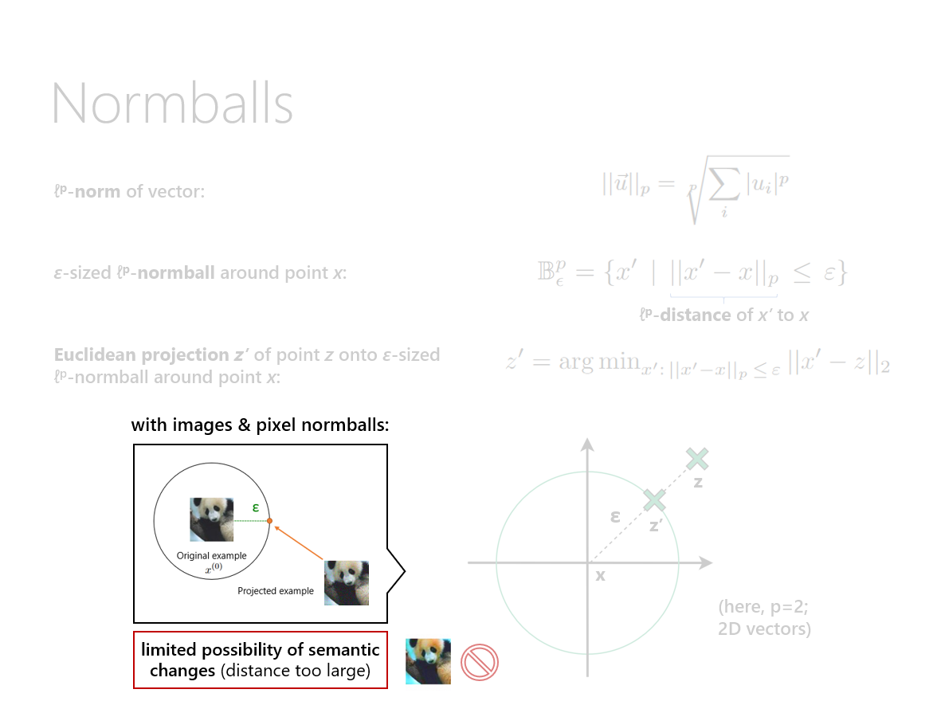
Meaningless Perturbation
Notes:
Now, recall from our discussion about normballs earlier that we noted the limited possibility of meaningful semantic changes when using adversarial attacks limited to pixel normballs.
10:40

Slide 16
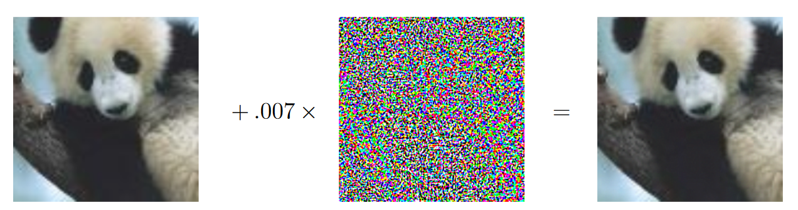
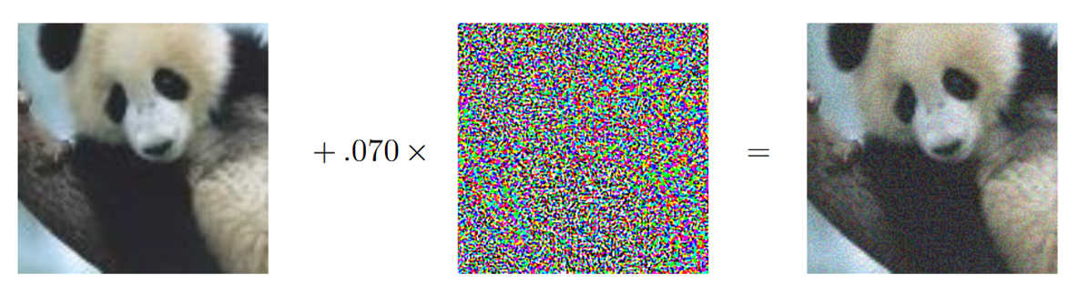
Meaningless Perturbation
➜ no meaningful semantic difference to human observer!
Notes:
This can already be seen in the motivating example we had in the beginning, where we cannot see any difference between the original image and the adversarial example.
Even if we were to increase the magnitude of the noise added to the original image, the resulting example would simply be a noisier version of the original one,
(click)
yet the semantics of the two images would remain the same.
11:06
---
Noise is not Gaussian (not even random), but we move into direction of another class/away from original class

Slide 17



More Meaningful Perturbations
Paper’s approach:
Change scene parameters instead of directly changing pixels to obtain adversarial examples
➔ Can significantly alter image’s pixels by introducing semantic, plausible changes (e.g. illumination shifts), while still remaining photorealistic!
Which parameters of the scene can be changed?
U₁
U₂
V₁
V₂
Lighting parameters U
Geometric parameters V
➔ Image-generating function I(U, V) gives pixels from scene parameters
Notes:
As an alternative to changing the original image’s pixels when generating adversarial examples in the case of images, the work we are about to discuss considers changing the scene-generating parameters to obtain adversarial examples.
(click) A very important advantage this gives us is that we can now introduce semantic and plausible changes to the image, thereby heavily altering the image’s pixels, and meanwhile we are still able to avoid the heavy distortion artifacts we saw earlier.
(click) We split the changeable parameters characterizing a scene into two groups: the lighting parameters U, and the geometric parameters V. The meanings of these parameters are illustrated here, and the fact that those are two independent groups of parameters should be intuitive. So, changing the lighting of the scene will leave its geometry unaltered, and vice versa.
Finally, we define an image-generating function I of U and V, which gives us pixels after receiving the lighting and geometic parameters as input.
12:02

Slide 18
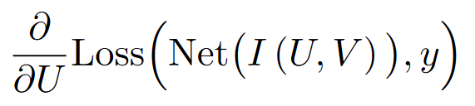
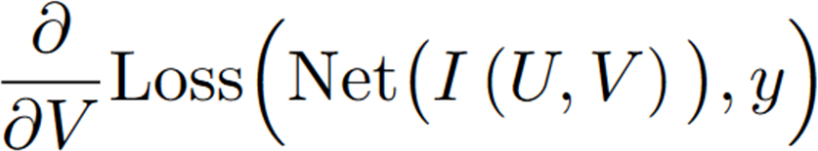
More Meaningful Perturbations
Image-generating function I(U, V) gives pixels from scene parameters
Our aim: be able to compute
and
➔ I(U, V) must be differentiable w.r.t. U and V!
Notes:
Given this image-generating function I,
(click) our aim is to be able to compute the derivatives of the loss with respect to U and V, to be able to use them for constructing adversarial examples in the manner we saw before.
(click) Very importantly, this means that our image-generating function must be differentiable w.r.t. U and V.
12:25

Slide 19
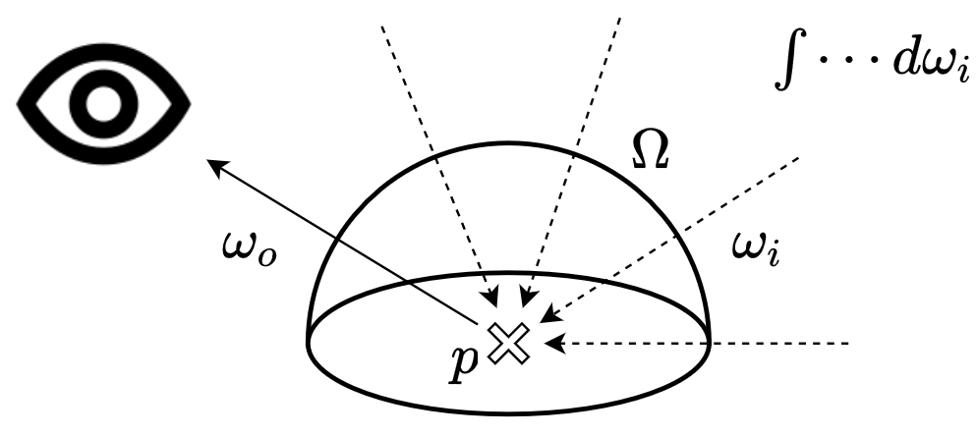
Towards a Differentiable I(U, V)
Rendering equation (Kajiya, 1986) describes propagation of light through point in space (used to render CGI images):
reflection of light from material at point p
point in space
emitted radiance
incoming
angle
output
radiance
output
angle
incoming
radiance
surface normal at p
hemisphere of incoming angles
Notes:
Remember that we want to define an image-generating function taking the lighting parameters U and the geometric parameters V and producing an image, so a tensor of pixels
To define this function, we can start by considering Kajiya’s famous rendering equation, as shown here. It describes the propagation of light through a given point in space.
This might look intriguing at first, so I annotated the individual terms of the equation.
Also, here’s a diagram illustrating the main idea.
On the left-hand side of the equation, we have the output radiance of a point in space into some angle, which is what we want to calculate. This corresponds to the ray emerging with angle omega_o in the diagram.
On the right hand side, we first have a term describing the emitted radiance of the point itself. This term is only nonzero if point p is a light source and emits light into the direction omega_o.
Also, we have an integral over the hemisphere of all possible incoming angles. These angles are represented by the dashed lines in the diagram.
At each such angle, we have a term describing the reflection of light from the material at point p, another term describing the incoming radiance at point p, and a final term depending on the current incoming angle and the surface normal at point p.
13:55

Slide 20
Towards a Differentiable I(U, V)
Rendering equation (Kajiya, 1986) describes propagation of light through point in space (used to render CGI images):
reflection of light from material at point p
point in space
emitted radiance
incoming
angle
output
radiance
output
angle
incoming
radiance
surface normal at p
hemisphere of incoming angles
Goal: simplify right-hand side and try to obtain expression that is differentiable w.r.t. U and V, so we can take
and
…and find adversarial examples by changing U and V accordingly
Notes:
Our goal will be to simplify the right-hand side and obtain an expression that is differentiable w.r.t. U and V.
All this is of course done so that we can find adversarial examples by changing the lighting and geometry parameters used to generate the image, just in the same way we originally changed pixels of the image to find adversarial examples.
14:22

Slide 21
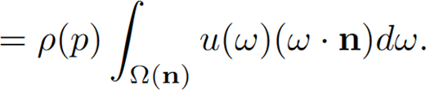
Simplifying the rendering equation:
reflection of light from material at point p
point in space
emitted radiance
incoming
angle
output
radiance
output
angle
incoming
radiance
surface normal at p
hemisphere of incoming angles
assume objects don’t emit light themselves
assume all points illuminated uniformly
assume incoming light
gets reflected uniformly
no ω_{o} and u_{o} in term
anymore, so ω_{i} = ω, u_{i} = u
➔ many simplifying assumptions
➔ some loss of realism
assume each light particle bounces off only one surface
➔ reduce integration to upper hemisphere; assume no light from other objects
Notes:
Let’s start simplifying the rendering equation. We have the original equation shown here again.
What we will do next is make a series of simplifying assumptions on the lighting of the scene.
(click) We will first assume that there is only one light source, meaning that objects do not emit light themselves. This helps us get rid of the first term.
(click) We further assume that all points are illuminated uniformly, so the incoming radiance does not depend on the point we are looking at.
(click) Next, we assume that all incoming light gets reflected uniformly, which makes the light reflection term independent of the input and output angles.
Taking all this together already gives us this expression here.
(click) In the expression, we simplify some notations since we don’t use the output angle and output radiance anymore.
(click) By assuming that each light particle bounces off only a single surface, we change the integration domain to the upper hemisphere that we saw in the diagram before.
(click) All this together then gives us the simplified rendering equation. The takeaway is that we make lots of simplifying assumptions to facilitate our subsequent analysis. This inevitably leads to some loss of realism in the generated images.
15:52

Slide 22
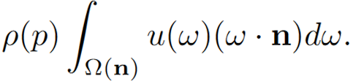
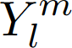

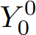
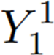
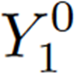
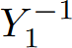
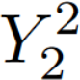
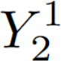
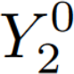
Towards a Differentiable I(U, V)
Rendering equation (Kajiya, 1986):
Simplified version:
lighting component
geometric component
We want to numerically integrate the simplified rendering equation
➔ choose appropriate basis on S² (thus on Ω(n) ⊆ S²) and represent integrand in that basis
➔ spherical harmonics : basis for functions defined on spheres
➔ rendering 99% accurate using only first few spherical harmonics basis functions
Notes:
Here, we see the original rendering equation and the simplified version that we just derived again.
(click) What we would like to do now is numerically integrate the simplified equation.
(click) We can do so by choosing an appropriate basis on the hemisphere of incoming angles S^2, and representing the integrand in this basis
(click) Spherical harmonics can be used to obtain a basis for functions defined on spheres. This means that every function defined on a sphere, including our integrand on Omega(n) here, can be represented using a sum of spherical harmonics.
(click) notably, rendering is considered to be 99% accurate under the simplifying assumptions we made before if we represent our function using only the first few spherical harmonics basis functions
(click) here’s a visualization of the first few spherical harmonics
16:55

Slide 23
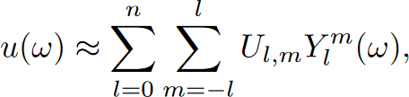
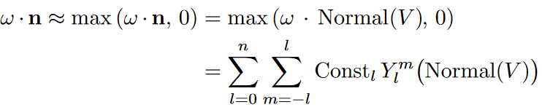
Towards a Differentiable I(U, V)
Rendering equation (Kajiya, 1986):
Simplified version:
lighting component
geometric component
Represent lighting & geometric components using spherical harmonics basis:
Lighting component:
spherical harmonics basis
functions (parameters: angles)
Geometric component:
Notes:
We can then represent both the lighting and the geometric components using the spherical harmonics basis parameterized by the angles that will be stated here shortly.
(click) The *lighting* component can be represented using a simple linear combination of spherical harmonics basis functions. The parameters of that combination are the scene’s lighting parameters.
(click) The *geometric* component can similarly be approximated by a linear combination of spherical harmonics basis functions. Here, the angles of the basis functions are given by the surface normal at the point of interest p.
17:45

Slide 24
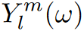
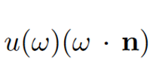
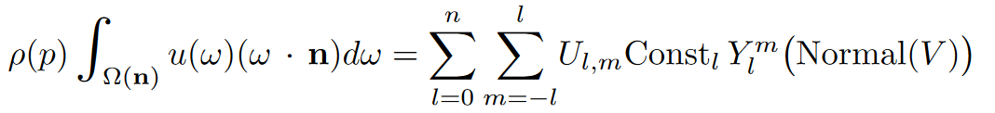
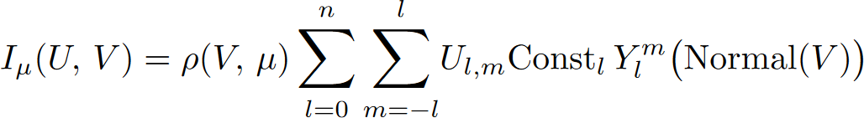
Lighting component:
spherical harmonics basis
functions (parameter: angle)
Geometric component:
➔ Integral over in simplified rendering equation marginalizes of lighting component
➔ Spherical harmonics functions are orthogonal, so dot product simplifies to just two instead of four sums:
simplified rendering equation
Finally, incorporating a pixel-to-point mapping function μ, we obtain the desired differentiable I(U, V):
texture of V mapped to image
lighting parameters
➔ can now generate
adversarial examples
based on U and V
differentiable image-generating function
geometric
parameters
Notes:
Let’s plug in the new representations of the lighting and geometric components into the simplified rendering equation.
(click)
(click) First, we notice that the integral over ω marginalizes the spherical harmonic basis function Y_l^m of the lighting component
(click) Also, since spherical harmonics functions are orthogonal, the dot product in the simplified rendering equation results in just two instead of four sums. This gives us the following integral-free representation of the simplified rendering equation, already containing our two parameter groups U and V.
(click) Finally, if we incorporate a pixel-to-point mapping function μ, we obtain our desired differentiable I(U, V), which has the form shown here incorporating both the lighting parameters and the geometric parameters.
(click)Now we can finally differentiate the image with respect to U and V and generate adversarial examples using the methods we saw before.
19:05

Slide 25
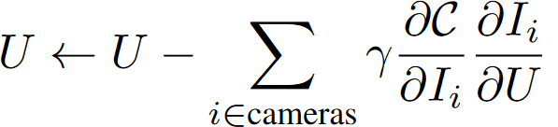
Resulting Adversarial Examples
Cost function:
label to decrease confidence for
label to increase
confidence for
classifier
untargeted attack
targeted attack (optional)
Two dimensions of adversarial examples:
Adversarial lighting vs. Adversarial geometry
Single-view vs. Multi-view
e.g. for multi-view adversarial lighting:
Notes:
After all these theoretical considerations, let’s look at the results of the paper and some actual adversarial examples that we generate from this framework.
(click) The cost function the authors use here offers the possibility of using both a targeted and an untargeted attack.
Both times, a cross-entropy loss is used. We have to specify a label L_d to decrease confidence for, which would correspond to the ground-truth label of the example. We can also optionally specify another label L_i to increase the confidence for.
The authors further distinguish two orthogonal classifications of adversarial examples:
First, they categorize adversarial examples based on whether the lighting or the geometry parameters of the scene were altered. In no instance do the authors alter both in the same attack.
The authors furthermore explore multi-view adversarial examples in addition to the well-known single-view ones.
Multi-view adversarial examples optimize the cost function over multiple views of the same scene. The update formula for the lighting parameters in a multi-view adversarial setting would, for instance, look as follows.

Slide 26
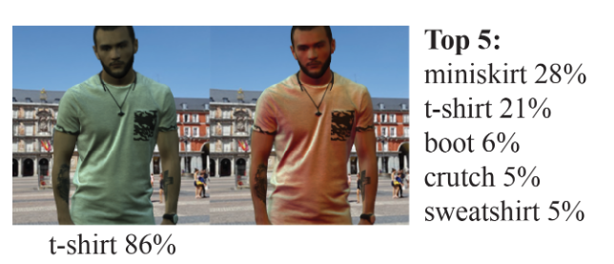
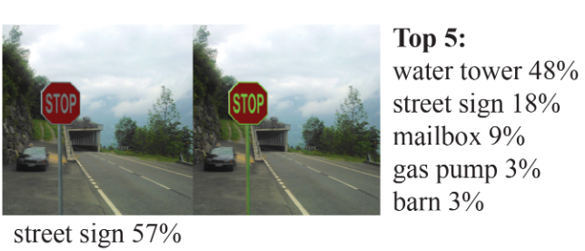
Resulting Adversarial Examples
Two dimensions of adversarial examples:
Adversarial lighting vs. Adversarial geometry
Single-view vs. Multi-view

Slide 27

Resulting Adversarial Examples
Two dimensions of adversarial examples:
Adversarial lighting vs. Adversarial geometry
Single-view vs. Multi-view
Constrain to only 3 adjustable skylight parameters
Before: 49 lighting parameters
➔ Still able to find an adversarial example!

Slide 28


Resulting Adversarial Examples
Two dimensions of adversarial examples:
Adversarial lighting vs. Adversarial geometry
Single-view vs. Multi-view

Slide 29


Resulting Adversarial Examples
Two dimensions of adversarial examples:
Adversarial lighting vs. Adversarial geometry
Single-view vs. Multi-view

Slide 30


Resulting Adversarial Examples
Two dimensions of adversarial examples:
Adversarial lighting vs. Adversarial geometry
Single-view vs. Multi-view
Notes:
Prof:
-> if outside data distribution: easy to cross into domain of other class
-> this is why we need access to model / white-box attacks
-> analogy with data on line
-> in very high-dimensional space: many unexplored gradients
-> e.g. 2D, but data in 1D -> in second dimension, anything can happen
-> analogy to error-correcting codes
Bats in cave analogy
-> mention: benefit is that we can distort image a lot and still be close to original image
-> say: can happen in real life, e.g. different lighting conditions (stop sign, boots, …)
-> this is the main point

Slide 31

Transfer of Adversarial Examples
These adversarial examples work on ResNet
Natural question: do adversarial examples for one model transfer to other models?
➔ commonly seen in normball-based adversarial examples
Generate 10.000 lighting-based and 10.000 geometry-based adversarial examples by backpropagating through ResNet, then attack other networks
Success rates of attacks:
➔ transfer works reasonably well ✔️
➔ going from white-box to black-box attack

Slide 32

"Real-Life" Adversarial Robustness
Can our artificial adversarial examples aid in making models more robust against real-life adversarial attacks?

Slide 33

"Real-Life" Adversarial Robustness
Real-life adversarial test set: 500 photos of oranges illuminated by projector
Good example of black-box attack
Train WideResNet on CIFAR-100, optionally add additional data
Training set | CIFAR-100 (+) no additional data | CIFAR-100 (+) 100 additional samples random lighting | CIFAR-100 (+) 100 additional samples adversarial lighting
Resulting accuracy | 4.6% | 40.4% | 65.8%
➔ Method can be used for defense against real-life adversarial attacks

Slide 34
Evaluation of Paper
Paper rated positively on OpenReview for ICLR 2019 ^{[1]}
➔ all reviewers suggest acceptance of paper for conference
➔ multiple suggestions made; authors incorporated most of them
^{Positive points:}
✔️ novel idea: use differentiable renderer to generate meaningful adversarial perturbations
✔️ detailed explanation of physically-based rendering
✔️ exploration of adversarial attack transfer
✔️ exploration of suitability for defense against real-life attacks
^{Negative points:}
❌ code not publically available
[1] https://openreview.net/forum?id=SJl2niR9KQ

Slide 35

Q&A
Thank you for your attention!
Download these slides:
https://polybox.ethz.ch/index.php/s/GnQLLTdrWzL5CDk
Alexey Gavryushin | agavryushin@student.ethz.ch
ETH Zurich | Advanced Topics in ML & Data Science | 18 May 2022

Slide 36
Backup slides

Slide 37


Normballs
ε
-ε
ε
x
-ε
Notes:
Let’s look at some types of normballs.
The most commonly encountered normballs in the adversarial learning literature are the l1, l2 and l-infinity normballs, which you see here. In the illustration, these normballs are all centered around the origin.
The l1 normball of radius epsilon is shown here in red and looks like a rhombus. The l2 normball, shown in green, is a circle of radius epsilon, and is a superset of the l1 normball.
The l infinity normball, in blue here, is a square of side length 2ε and is in turn a superset of the l2 normball.
SUBSET -> PROPER SUBSET!

Slide 38





Spherical Harmonics
Source: en.wikipedia.org

Slide 39

Adversarial Examples (Humans)
Beuchet Chair; Photograph by Markus Elsholz

